Slide 1
AI Gold Price Predictor
Gold Prize Predictor Project
Fazeel Muhammad | Muhammad Salman
Instructor: Atif Luqman
Artificial Intelligence Project · 2026

Slide 2
Project Overview
🎯 Objective
📊 Data Range
Predict gold prices in USD & PKR for 2025–2028 using 10 years of historical data
January 2014 – December 2024 (monthly data stored in SQLite database)
🤖 AI Models
🏆 Best Result
Linear Regression & Random Forest trained on market indicators and price history
Linear Regression achieved R² = 0.9796 — explains 98% of gold price variance

Slide 3
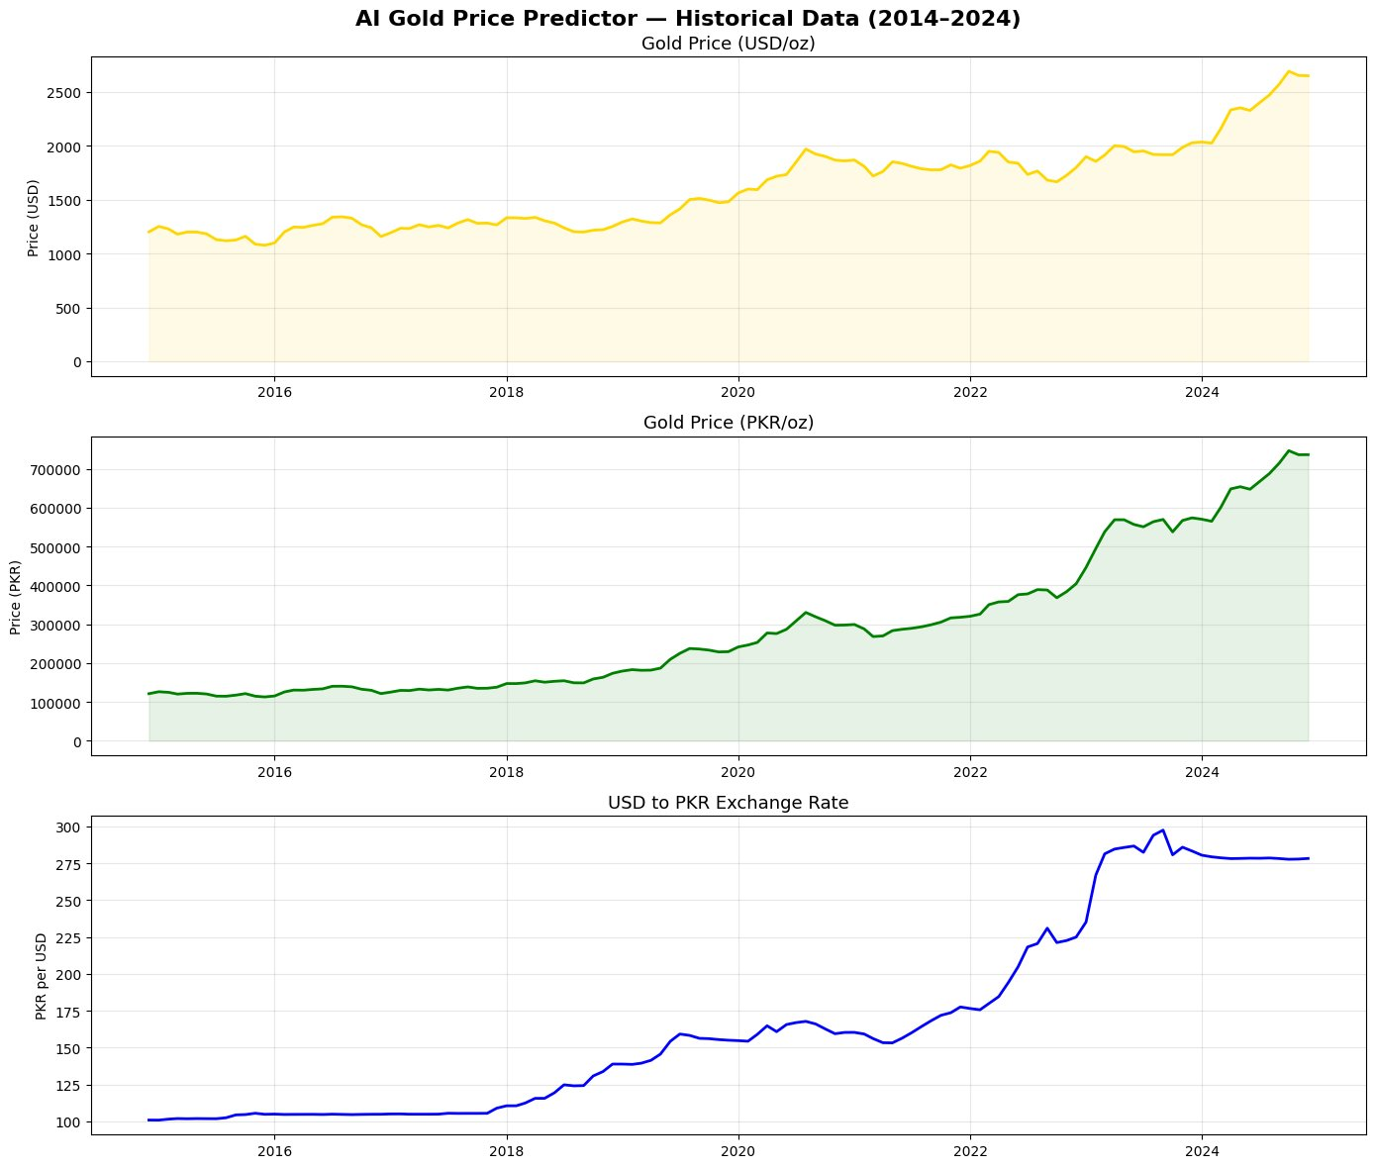
Historical Data & EDA (2014–2024)
Key Observations
Gold (USD): $1,200 → $2,650/oz (+121%)
Gold (PKR): 120K → 720K/oz (+500%)
PKR Rate: 100 → 280 per USD (+180%)
Sharp PKR devaluation visible in 2022–23
PKR depreciation is the key PKR amplifier
3 Tables in SQLite DB — Gold_Prices, Market_Indicators, Predictions

Slide 4
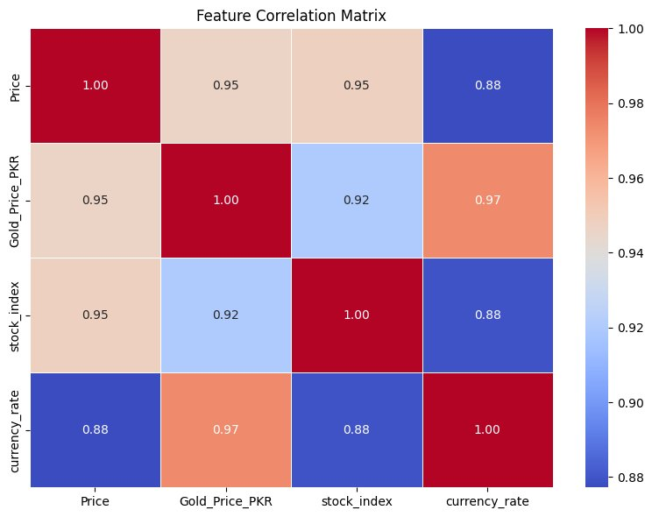
Feature Correlation Analysis
Key Insights
0.97
Currency Rate ↔ PKR Gold Price
(Highest correlation — PKR depreciation drives local gold prices)
0.95
USD Price ↔ Stock Index & PKR Price
(Global market linkage confirmed)
0.88
Currency Rate ↔ USD Gold Price
(Lower but still strong global-local linkage)
All correlations > 0.88 — Features are highly informative for prediction

Slide 5
Feature Engineering
Time
Price Lags
Rolling Avg
Currency
Market
Month_Num (trend)
Price_Lag1 (1-mo momentum)
MA_3 (3-month mean)
PKR_Lag1 (currency lag)
stock_index (S&P 500)
Month (seasonality)
Price_Lag3 (3-mo momentum)
MA_6 (6-month mean)
currency_rate (current)
Additional market data
After Feature Engineering: Dropped 'other_factors' (121 NaN values) → Clean dataset used for training
Train / Test Split
80% Training Set
20% Test
shuffle=False — preserves temporal order for realistic evaluation

Slide 6
Model Training & Evaluation
Linear Regression
Random Forest (200 trees)
0.9796
★ BEST MODEL
0.9213
max_depth=10
R² Score
R² Score
n_estimators=200
RMSE: ~$41.20 MAE: ~$31.50 Strength: Captures linear long-term gold trend perfectly
RMSE: ~$89.50 MAE: ~$62.30 Note: Overfits training patterns; less accurate on extrapolation
Explains 98% of gold price variance
Explains 92% of gold price variance

Slide 7
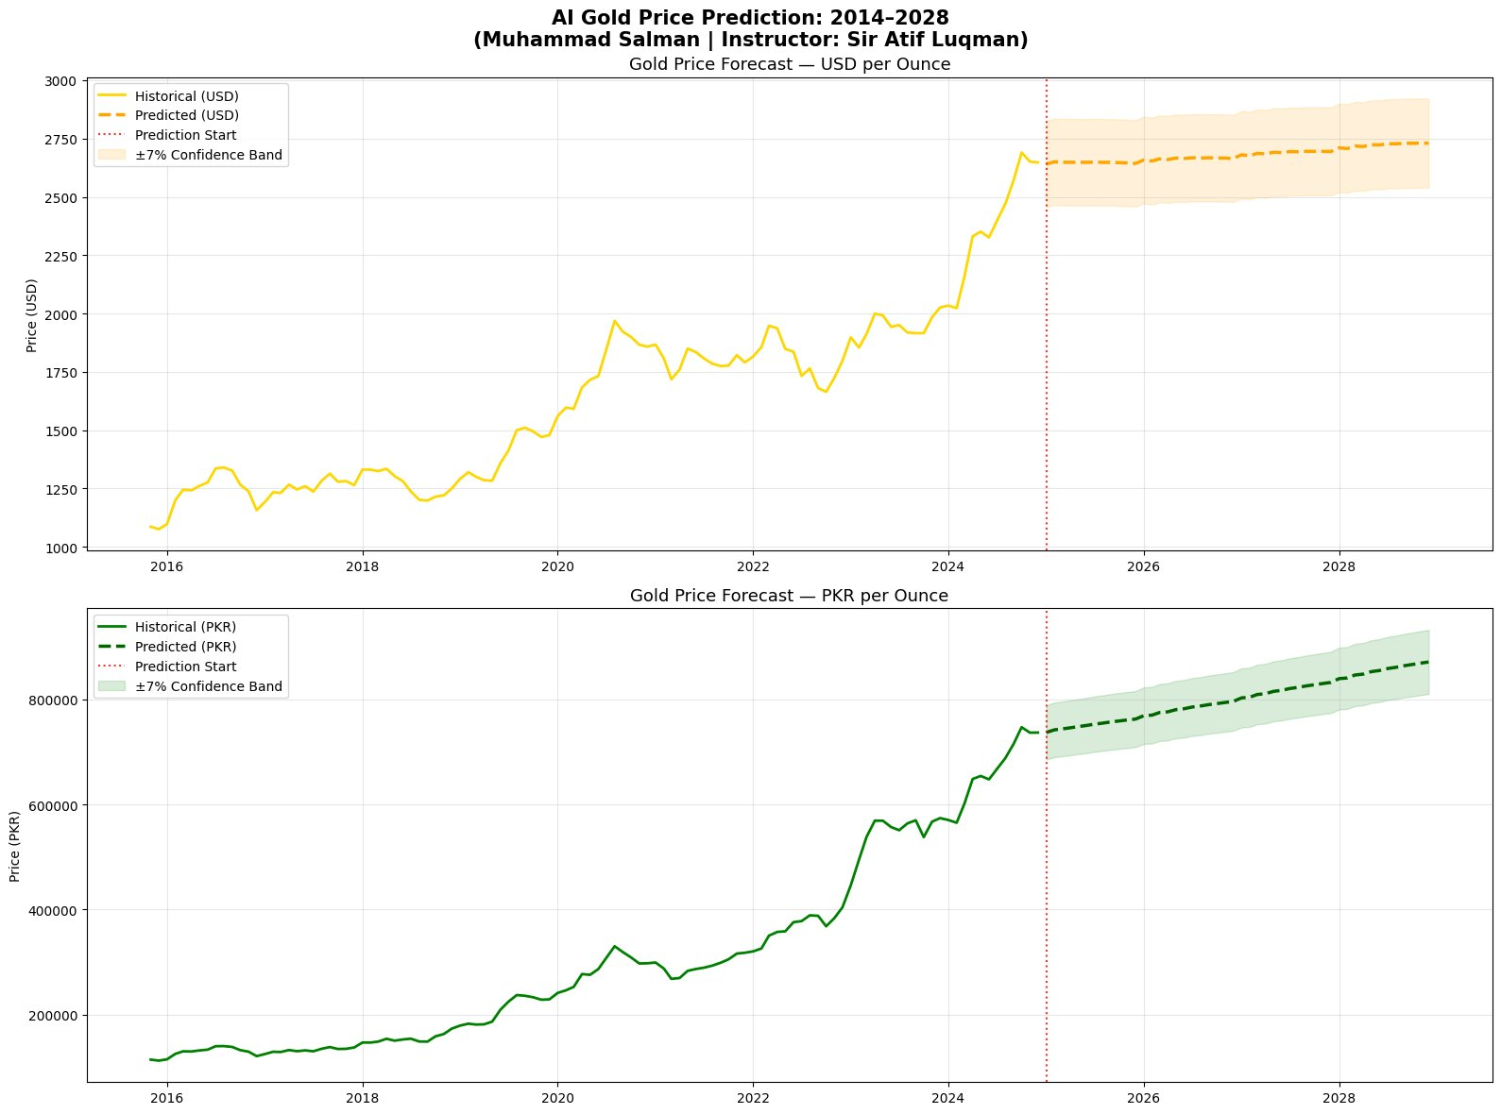
Gold Price Forecast: 2025–2028
USD: ~$2,690 → ~$2,752/oz (+2.3%)
PKR: ~750,000 → ~870,500/oz (+16%)

Slide 8
Price Milestones & Forecast Details
Period
USD / oz
PKR Rate
PKR / oz
Jan 2025
$2,690
279.1
PKR 750,900
Jun 2025
$2,700
283.4
PKR 765,200
Jan 2026
$2,715
287.5
PKR 780,600
Dec 2026
$2,728
297.3
PKR 811,000
Jun 2027
$2,736
302.0
PKR 826,500
Jan 2028
$2,743
306.6
PKR 841,000
Dec 2028
$2,752
316.3
PKR 870,500
± 7% Confidence Band applied on all forecasts

Slide 9
Database Architecture
gold_predictor.db (SQLite)
Gold_Prices
Market_Indicators
Predictions
Date (PK)
Date (PK)
ID (PK)
Price (USD/oz)
stock_index
Date (YYYY-MM)
Gold_Price_PKR
currency_rate
predicted_price (PKR)
other_factors
→ JOIN → Training → Model → INSERT
48 prediction records saved (Jan 2025 – Dec 2028) | Old predictions cleared before each new run

Slide 10
Project Code Pipeline (9 Blocks)
1
→
2
→
3
→
4
→
5
→
6
→
7
→
8
→
9
Imports
Load Data
EDA
Features
Train Models
Predict
Visualize
Save to DB
Summary
pandas, numpy, sklearn, sqlite3
SQLite → DataFrame → Merge
Historical plots + Correlation
Lags, Rolling Avg, Time
LR + RF → Evaluate
Iterative 2025–2028 forecast
USD & PKR forecast charts
INSERT into Predictions table
Print metrics + milestones
Technologies Used
Python 3
pandas
NumPy
scikit-learn
Matplotlib
Seaborn
SQLite3
Output Files: gold_historical_data.png | correlation_matrix.png | gold_price_forecast_2028.png | gold_predictor.db

Slide 11
Conclusions & Future Work
✓ Key Findings
→ Future Enhancements
LR (R²=0.9796) outperformed RF — gold trend is fundamentally linear over long term
Add CPI, Fed interest rates, and oil prices as features
PKR depreciation is the main driver of local gold price increases
Explore LSTM neural networks for time-series forecasting
Gold (USD) projected: $2,690 → $2,752/oz over 4 years (+2.3%)
Build real-time data pipeline with gold price APIs
Gold (PKR) projected: 750K → 870K/oz (+16%) due to currency effect
Develop Streamlit/Flask web dashboard for live predictions
48 monthly predictions saved to SQLite database
Model sudden PKR devaluation scenarios explicitly

Slide 12
Thank You!
AI Gold Price Predictor
Fazeel Muhammad | Muhammad Salman
Instructor: Atif Luqman
Questions & Discussion

